Slide 1

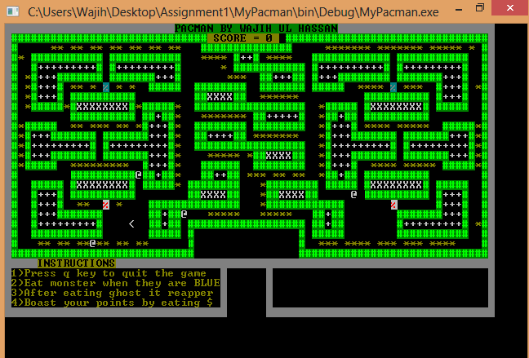
Pacman
CS 240
Wajih Ul Hassan
Concord University, Department of Computer Science, Athens WV 24712
Spring 2014
Introduction
Goals
Pacman is an arcade game of the 80’s where the player controls the agent through a maze filled with pills and ghosts. Pacman has been used to teach basics of Artificial intelligence algorithms because its deterministic, stochastic and adversarial problem settings. Some of teachings include adversial search, Markov Decision Process and probabilistic tracking. So, Our project tries to make intelligent agent in this case agent are Ghosts. They try to move towards pacman fewer number of steps and try to predict where pacman would move in future and chose next plan accordingly.
The goal of Pacman is to eat as many pills , power pills or edible ghosts as possible. Four different ghosts pursue Pacman all over the maze. Life is lost if they touch Pacman. The game is over after there are no more lives available. The game starts with 3 lives. When pacman eats Powerpill , the speed of ghosts is reduced to half.
The ghost AI is very simple and shortsighted. The key to understanding ghost behavior is the concept of a target tile. The large majority of the time, each ghost has a specific tile that it is trying to reach, and its behavior revolves around trying to get to that tile from its current one. Ghost ever plan one step into the future as they move about the maze. The only restriction is ghost is not allowed to reverse the direction. The ghosts movement in game is not random. They exhibit three kinds of modes Chase, Scatter and Frightened. They change these modes at random interval of time. In Chase mode, the ghost uses the pacman position to select target tile and pursue Pacman. In Scatter mode, the ghosts have fixed target tile and each of which is located in different corners of maze. In Frightened mode, the ghost don’t have specific target tile and they move pseudorandomly. Using the Manhattan distance from the pacman the Ghost decides which is the shortest possible way to reach pacman. Decision occur at each intersection and adding randomness makes the movement of ghost more natural.
Adding more levels to game
Making maze more complex
Making ghost behavior more intelligent by making changes in chasing algorithm. One possibility is to change simple Euclidean distance formula for determining the shortest path to some complex algorithm.
Results
Acknowledgements
The game was played many by changing behaviors of ghosts. Apply different strategies on Ghost exhibit different results .Changing them make the from easy to difficult
Conclusions
References
The Pac-Man Dossier http://home.comcast.net/~jpittman2/pacman/pacmandossier.html
Toru Toru Iwatani - Programmers at Work
http://pacmanmuseum.com/history/Toru-atwork.php
Understanding Pac-Man Ghost Behavior
http://gameinternals.com/post/2072558330/understanding-pac-man-ghost-behavior
Do Not Write Below this Line

